Slide 1

COVID-19 Growth Curve Models Paper
서울대학교 박태성 교수님
생물정보통계 연구실
박사과정 구태완 석사과정 한결희, 허규진, 이도은, Catherine Apio
학부과정 고영현, 김태현, 김학용, 이종혁, 정혜원, 허승우

Slide 2
ECDC
213
Segmentation
156
Logistic
134
Logistic
98
Gompertz
123
Gompertz
84
Segmentation Criteria
Fitting GCMs
MSSE Criteria

Slide 3
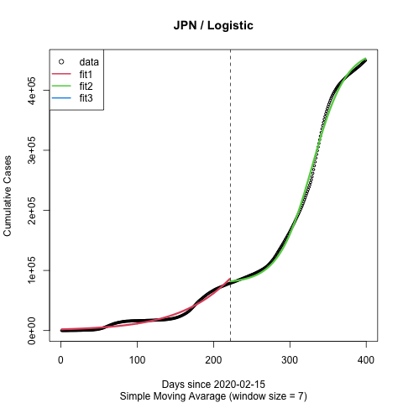
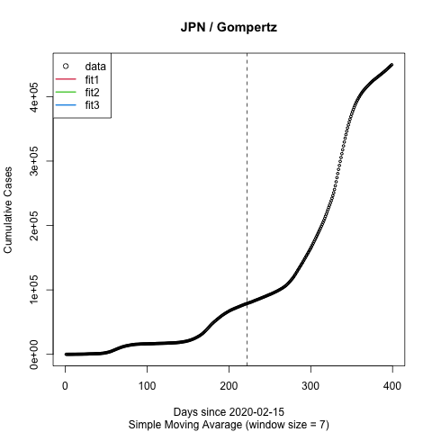
A
B

Slide 4
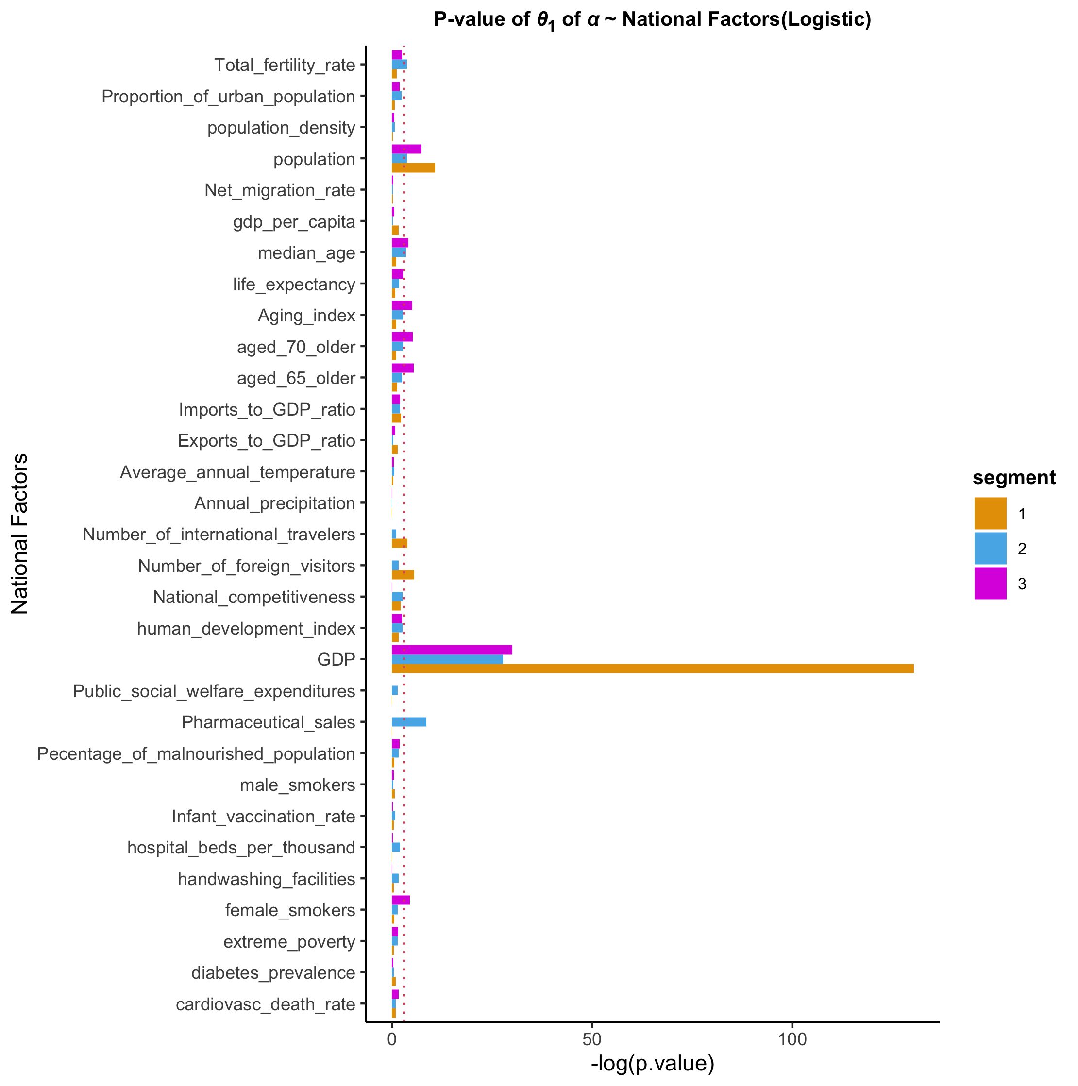
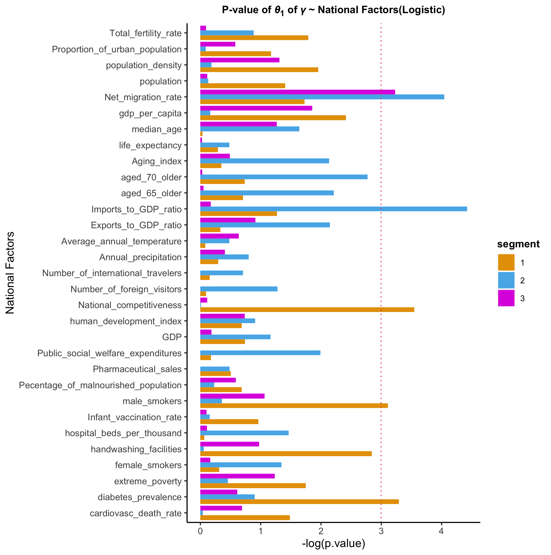
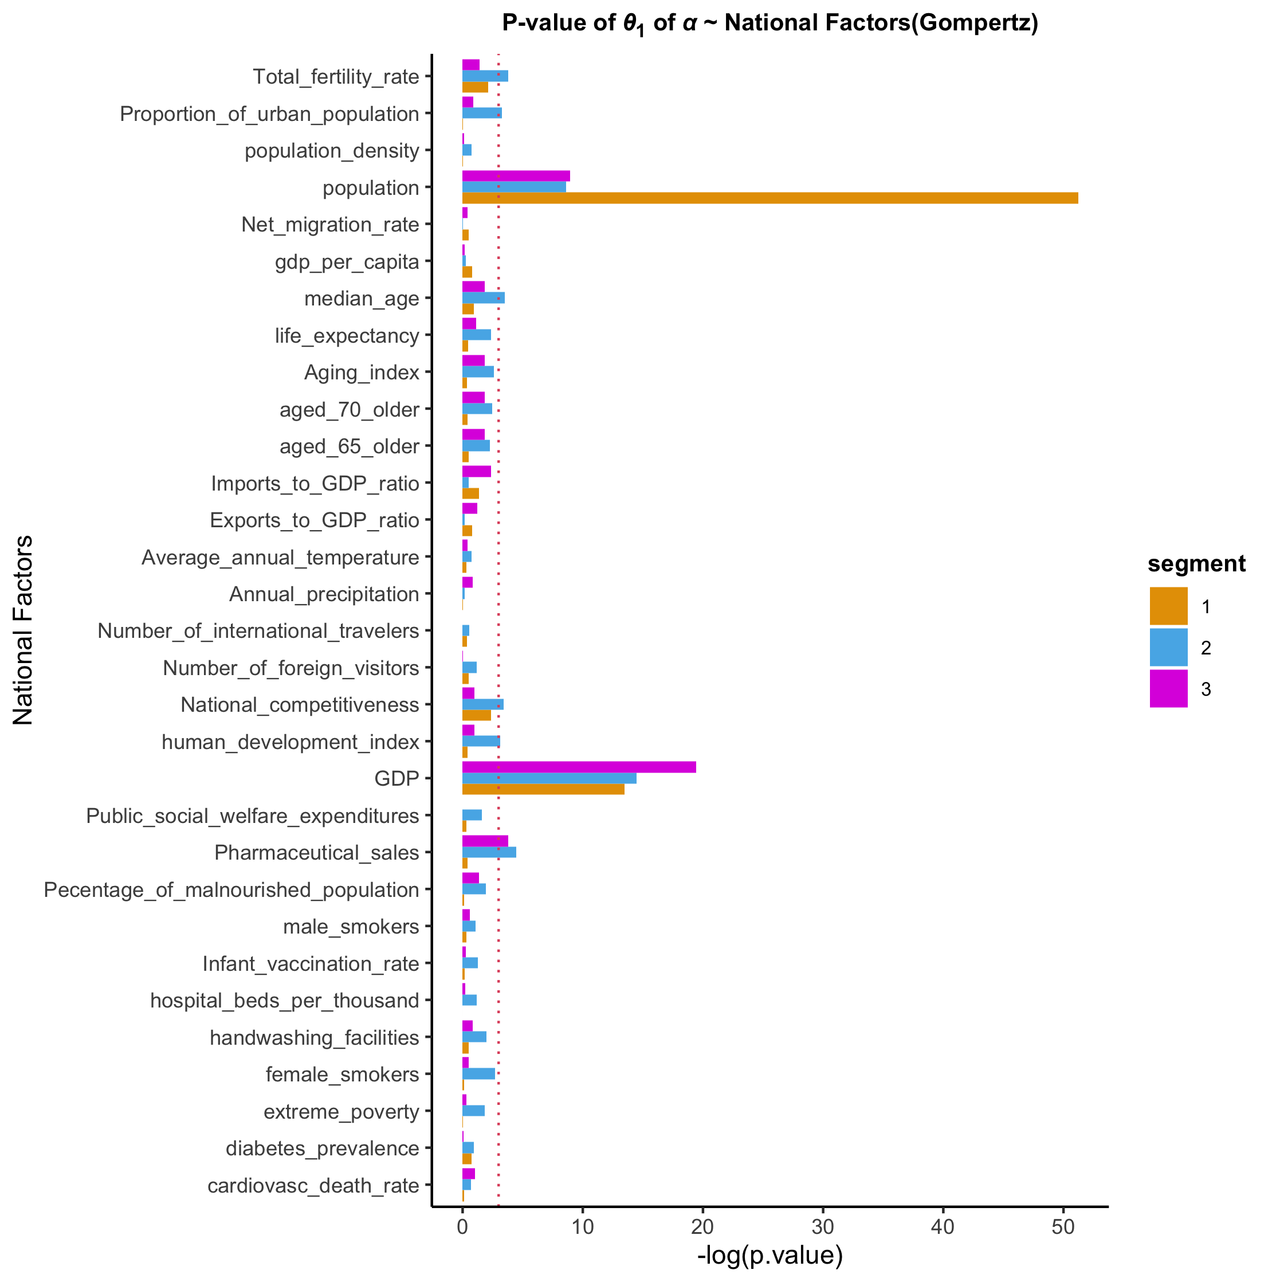
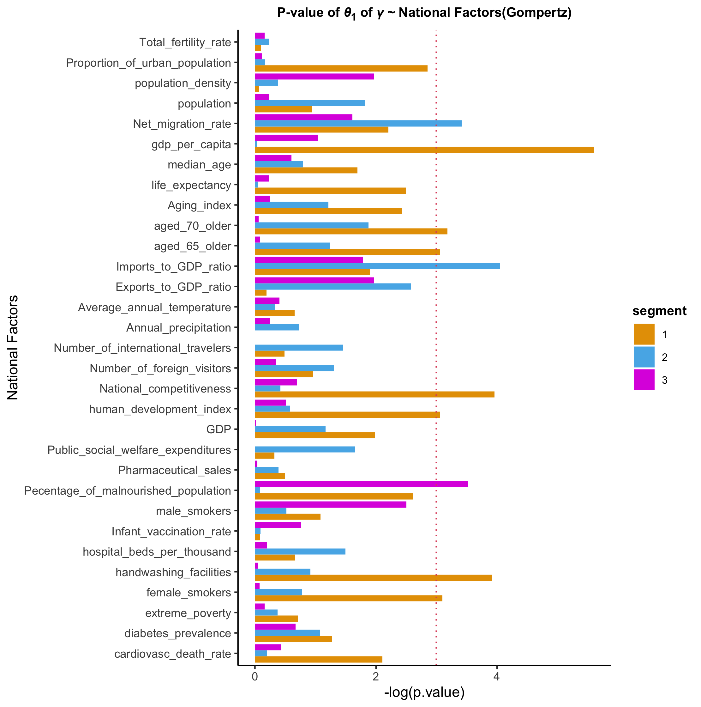
A
B
C
D

Slide 5
Commonly significant variables
[parameter a]
6 : GDP / population
3 : median_age (a2_Logi, a2_Gom, a3_Logi)
2 : Total_fertility_rate (a2_Logi, a2_Gom)
1 : HDI (a2_Gom) / female_smokers(a3_Logi) / aged_65_older (a3_Logi) / aged_70_older (a3_Logi) / Aging_index (a3_Logi)
[parameter c]
3 : Net_migration_rate (c2_Logi, c2_Gom, c3_Logi)
2 : National_competitiveness (c1_Logi, c1_Gom) / Imports_to_GDP_ratio (c2_Logi, c2_Gom)
1 : diabetes_prevalence (c1_Logi) / male_smokers(c1_Logi) / HDI (c1_Gom) / handwashing_facilities (c1_Gom) / female_smokers (c1_Gom) / aged_65_older (c1_Gom) / aged_70_older (c1_Gom) / gdp_per_capita (c1_Gom) / Malnourished_population (c3_Gom)

Slide 6



Growth Curve Analysis of 3rd freeze data : Venn diagram of significant national factors
Results
Logistic ($γ$)/ Segment 1
National competitiveness
Diabetes prevalence
Male smokers
Imports to GDP ratio
Net migration rate
Logistic ($γ$)/ Segment 3
Logistic ($γ$)/ Segment 2
Notes:
The risk for severe illness with COVID-19 increases with age, due to already a deteriorating immune system, pre-existing conditions and underlying medical problems (like cardiovascular disease, diabetes, chronic respiratory disease, and cancer) that also makes them prone to newer infections. This includes percentage of female and male smokers in the population (smoking is one of the world’s largest health problems) cardiovascular death rate.

Slide 7



Growth Curve Analysis of 3rd freeze data : Venn diagram of significant national factors
Results
Logistic ($α$) / Segment 1
GDP
Population
Female smokers
Aged 65 older
Aged 70 older
Aging index
Total fertility rate
Median age
Logistic ($α$) / Segment 3
Logistic ($α$) / Segment 2
Notes:
The risk for severe illness with COVID-19 increases with age, due to already a deteriorating immune system, pre-existing conditions and underlying medical problems (like cardiovascular disease, diabetes, chronic respiratory disease, and cancer) that also makes them prone to newer infections. This includes percentage of female and male smokers in the population (smoking is one of the world’s largest health problems) cardiovascular death rate.

Slide 8



Growth Curve Analysis of 3rd freeze data : Venn diagram of significant national factors
Results
Gompertz ($γ$)/ Segment 1
National competitiveness
Human development index
Handwashing facilities
Female smokers
Aged 65 older
Aged 70 older
GDP per capita
Malnourished population
Net migration rate
Imports to GDP ratio
Gompertz ($γ$)/ Segment 3
Gompertz ($γ$)/ Segment 2
Notes:
The risk for severe illness with COVID-19 increases with age, due to already a deteriorating immune system, pre-existing conditions and underlying medical problems (like cardiovascular disease, diabetes, chronic respiratory disease, and cancer) that also makes them prone to newer infections. This includes percentage of female and male smokers in the population (smoking is one of the world’s largest health problems) cardiovascular death rate.

Slide 9



Growth Curve Analysis of 3rd freeze data : Venn diagram of significant national factors
Results
Gompertz ($α$) / Segment 1
GDP
Population
Median age
Total fertility rate
Human development index
Gompertz ($α$) / Segment 3
Gompertz ($α$) / Segment 2
Notes:
The risk for severe illness with COVID-19 increases with age, due to already a deteriorating immune system, pre-existing conditions and underlying medical problems (like cardiovascular disease, diabetes, chronic respiratory disease, and cancer) that also makes them prone to newer infections. This includes percentage of female and male smokers in the population (smoking is one of the world’s largest health problems) cardiovascular death rate.

Slide 10
Commonly significant variables
[parameter a]
- In both GCMs, GDP and Population have a significant impact on the confirmed cases in every 3 segments.
- Aging factors, such as median age, aged_70_older, aged_65_older are significant on the confirmed cases in the third segment fitted by Logistic model. Especially, median age is also significant in among the second segment fitted by both Logistic and Gompertz model.
[parameter c]
- The most significant variable is Net_migration_rate. P-values of parameter are under 0.05 In the second segment fitted by both GCMs and in the third segment fitted by only Gompertz model.
- Imports_to_GDP_ratio is also significant variable in the second segment fitted by both GCMs.

